Slide 1


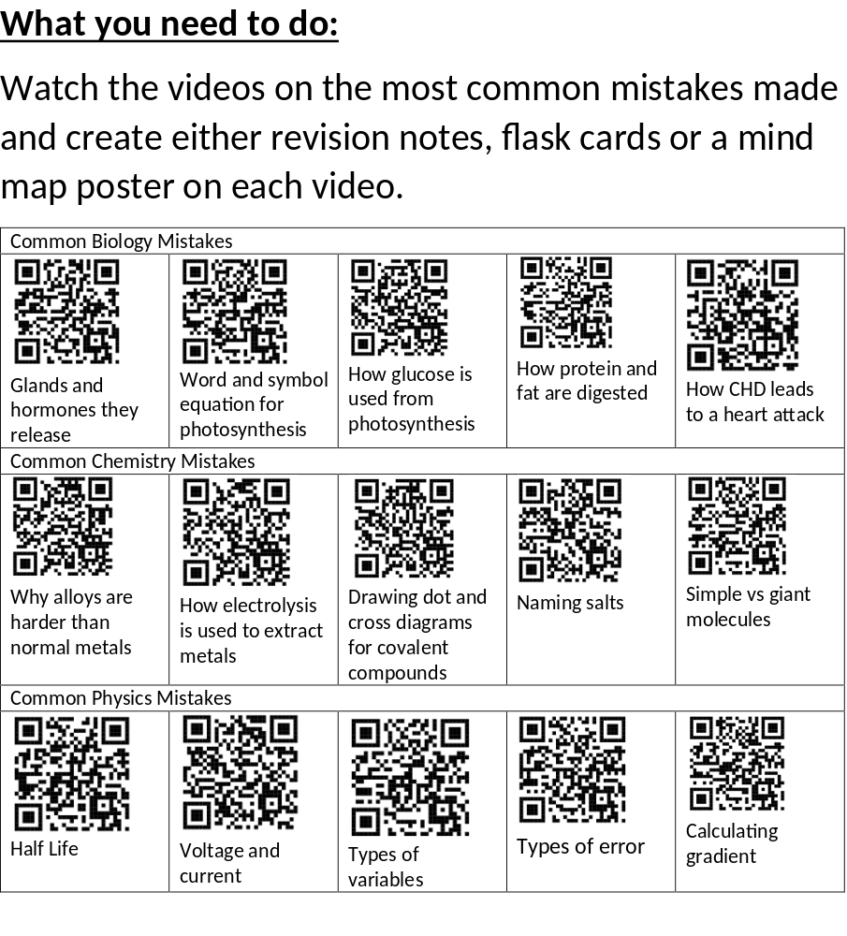

Year 11 Combined Science Christmas Homework
On Century Tech there are specific tasks set based on weak areas in mocks and Year 10 content.
Aim to do at least 25 mins a day which works out to 5 hrs total on Century over the holidays.
The top 5 students in each class whole spend the most time will get a prize.

